Slide 1

EDA OF PIZZA SALES
www.slidesgo.es
USING SQL
Naga Pavan Kumar

Slide 2


HELLO
This is Naga Pavan kumar in this project I tried to answer the questions relate to the pizza sales in 2015 using the SQL queries.

Slide 3
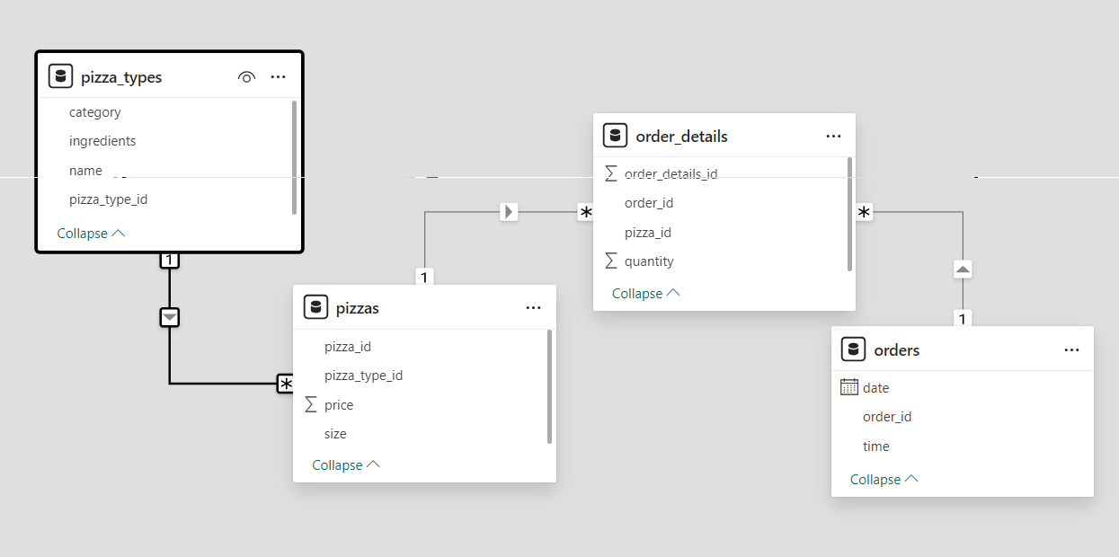

The data set contains the files
pizzas.csv: Contains information about pizza types.
pizza_types.csv: Provides details about pizza categories and prices.
orders.csv: Includes order information (order IDs, timestamps, etc.).
orders_details.csv: Contains transaction details (order items, quantities, and amounts).
These are having the schema as

Slide 4


Questions to be answered
Retrieve the total number of orders placed.
Calculate the total revenue generated from pizza sales.
Identify the highest-priced pizza.
Identify the most common pizza size ordered.
List the top 5 most ordered pizza types along with their quantities.
Join the necessary tables to find the total quantity of each pizza category ordered.
Determine the distribution of orders by hour of the day.
Join relevant tables to find the category-wise distribution of pizzas.
Group the orders by date and calculate the average number of pizzas ordered per day.
Determine the top 3 most ordered pizza types based on revenue.
Calculate the percentage contribution of each pizza type to total revenue.
Analyze the cumulative revenue generated over time.
Determine the top 3 most ordered pizza types based on revenue for each pizza category.

Slide 5
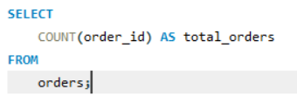
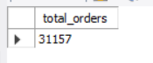
Retrieve the total number of orders placed.
The sql aggregate function count is used for the order_id column in the data set to find the total number of orders

Slide 6
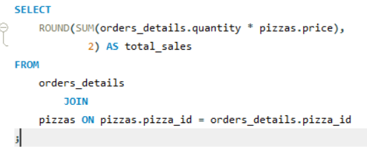
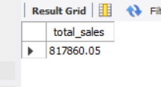
Calculate the total revenue generated from pizza sales.
To solve this question the revenue is obtained by multiplying quantity and price but as these two columns are not in the same table we should apply a join based pizza_id which is common column in the two tables.
And used the ROUND to limit the result to 2 decimal places.

Slide 7
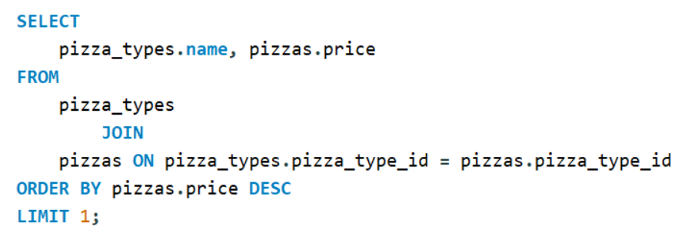
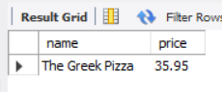
Identify the highest-priced pizza.
To solve this same JOIN is applied as the name and price where in the pizza_types and pizzas tables and the order by is applied to align by descending using DESC and the LIMIT is applied as 1 to get the highest priced pizza.

Slide 8

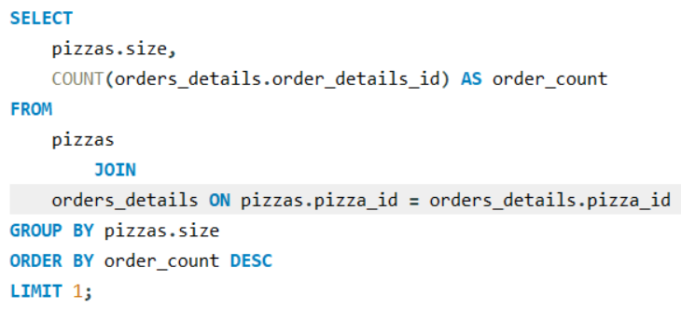
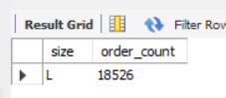
Identify the most common pizza size ordered.
To solve the question the aggregate function count is used on the order_details_id to know the order count and then as the size is pizza size is in pizzas JOIN is applied based on the pizza_id then the details where GROUP BY size, ORDER BY count using DESC and LIMIT by 1.

Slide 9
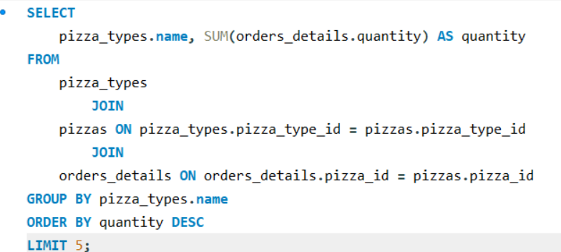
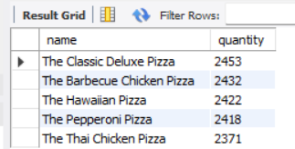
List the top 5 most ordered pizza types along with their quantities
To solve these the data required is in two unconnected tables but can be joined as the pizzas have both pizza_id and pizza_type_id can be joined by two INNER JOINS and GROUP BY name and ORDER BY quantity and LIMIT by 5.

Slide 10
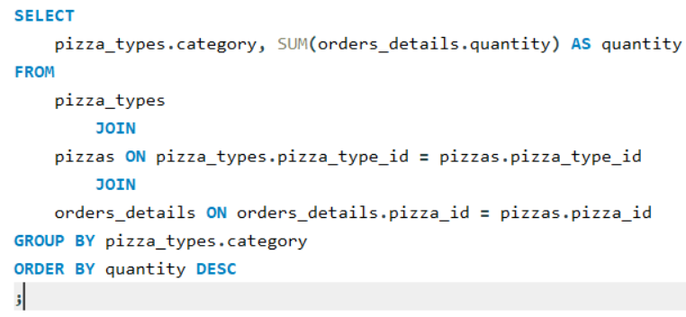
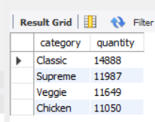
Join the necessary tables to find the total quantity of each pizza category ordered
To solve these the data required is in two unconnected tables but can be be joined as the pizzas have both pizza_id and pizza_type_id can be joined by two INNER JOINS and GROUP BY category and ORDER BY quantity.

Slide 11
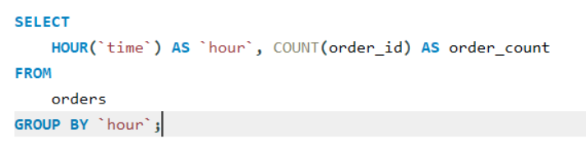
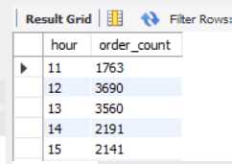
Determine the distribution of orders by hour of the day
The HOUR command in the sql gives the hour part of the date time and the order count by order_id COUNT and the results are grouped by the use of the hour here backticks are applied to the name hour as it is the command in the sql

Slide 12
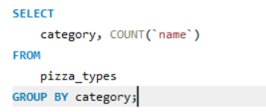
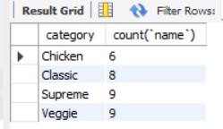
Join relevant tables to find the category-wise distribution of pizzas.
To solve this the COUNT is applied to names of the pizzas and GROUP BY to the category from the table pizza_types

Slide 13
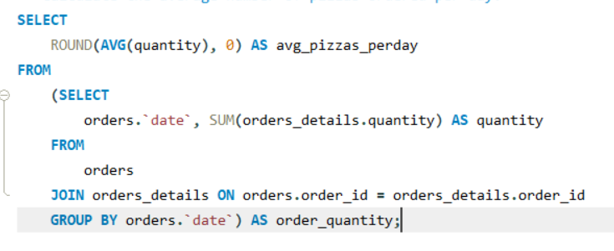
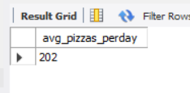

Group the orders by date and calculate the average number of pizzas ordered per day.
To get the average pizzas ordered by date first the AVG quantity was taken by rounding off to 0 then a subquery was written to get the order quantity by date and sum of quanity was taken joined by order_id and GROUP BY date. from the orders and order_details tables

Slide 14
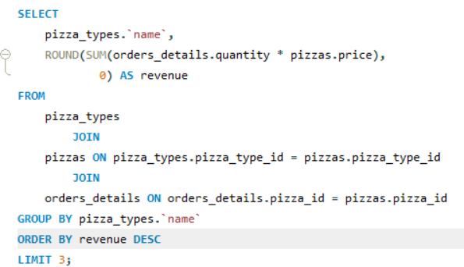
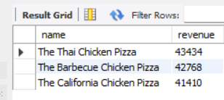
Determine the top 3 most ordered pizza types based on revenue
To get this the revenue and the pizza types has to be compared which are in two uncounted tables pizza_types and the order_details but can be joined by the pizzas table by the use of two INNER JOINS because it has pizza_id and pizza_type_id ﻿ and then the data is GROUP BY pizza_types and ORDER BY revenue DESC with LIMIT as 3.

Slide 15
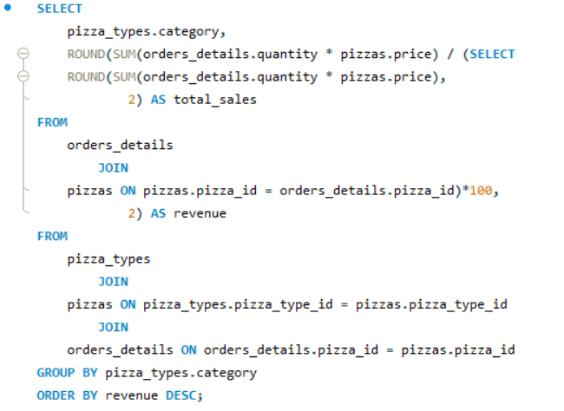
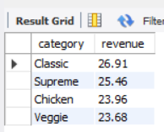
Calculate the percentage contribution of each pizza type to total revenue
The contribution of each pizza type can be known by writing a query to get the price and dividing it by the revenue (which is obtained by sub query in the code) and then pizza_types and order details were joined by the pizzas table by the use of two INNER JOINS because it has pizza_id and pizza_type_id ﻿ and then the data is GROUP BY pizza_types.category and ORDER BY revenue DESC.

Slide 16
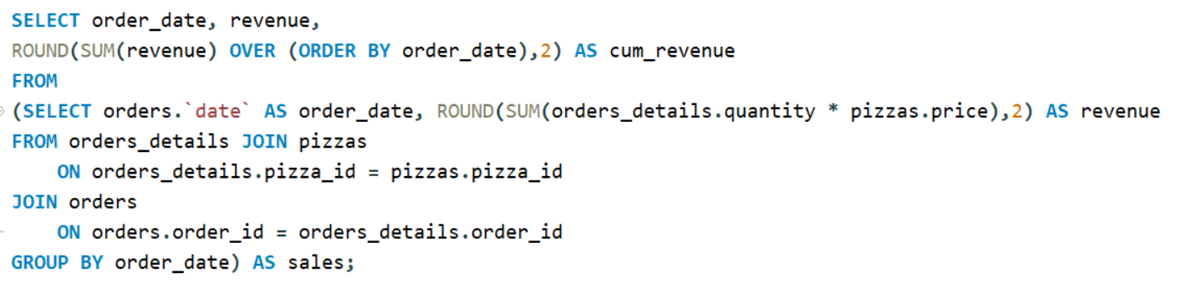
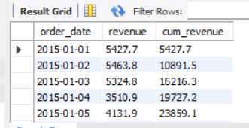
Analyze the cumulative revenue generated over time
The cumulative sum of the revenue can be obtained by the sum of revenue over the ordered by order_date and the of two INNER JOINS using the order details table as the common point.

Slide 17
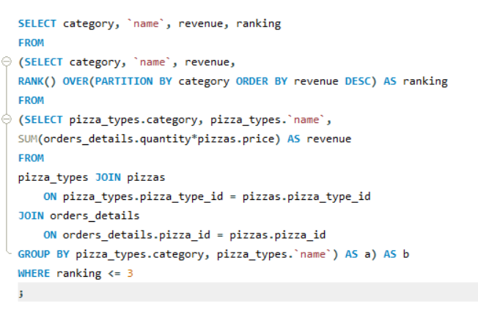
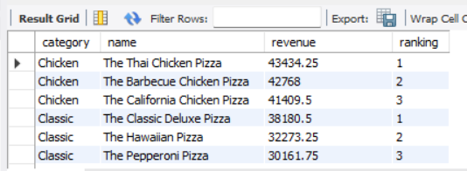
Determine the top 3 most ordered pizza types based on revenue for each pizza category
The required information for this query is pizza type, pizza and revenue generated by each pizza and finally we need to rank them so for the info we use TWO INNER JOINS and group them by both categoryand nem of the pizza and finally the ranking is provided by the use of the (OVER, PARTITION BY(using category), ORDER BY (using revenue)) these all are done by the use of sub query in the FROM section.

Slide 18
THANKS!

